Slide 1

Select Topics in Python Using NumPy
Notes:
‹#›

Slide 2

Objectives
Objectives
Introduction to NumPy.
Arrays.
NumPy operations.
Notes:
‹#›

Slide 3

Introduction of NumPy
Importing NumPy
https://numpy.org/install/
Notes:
Numpy is the core library for scientific computing in Python. It provides a high-performance multidimensional array object, and tools for working with these arrays.
A numpy array is a grid of values, all of the same type, and is indexed by a tuple of nonnegative integers. The number of dimensions is the rank of the array; the shape of an array is a tuple of integers giving the size of the array along each dimension.
Image from edureka.com
‹#›

Slide 4
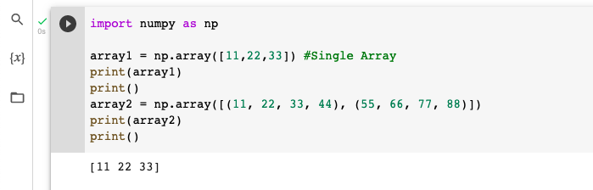
Create Array using NumPy
Arrays
Single-dimensional array.
Multidimensional array.
Notes:
We use python NumPy array instead of a list because of the below three reasons:
Less Memory
Fast
Convenient
The very first reason to choose python NumPy array is that it occupies less memory as compared to list. Then, it is pretty fast in terms of execution
‹#›

Slide 5
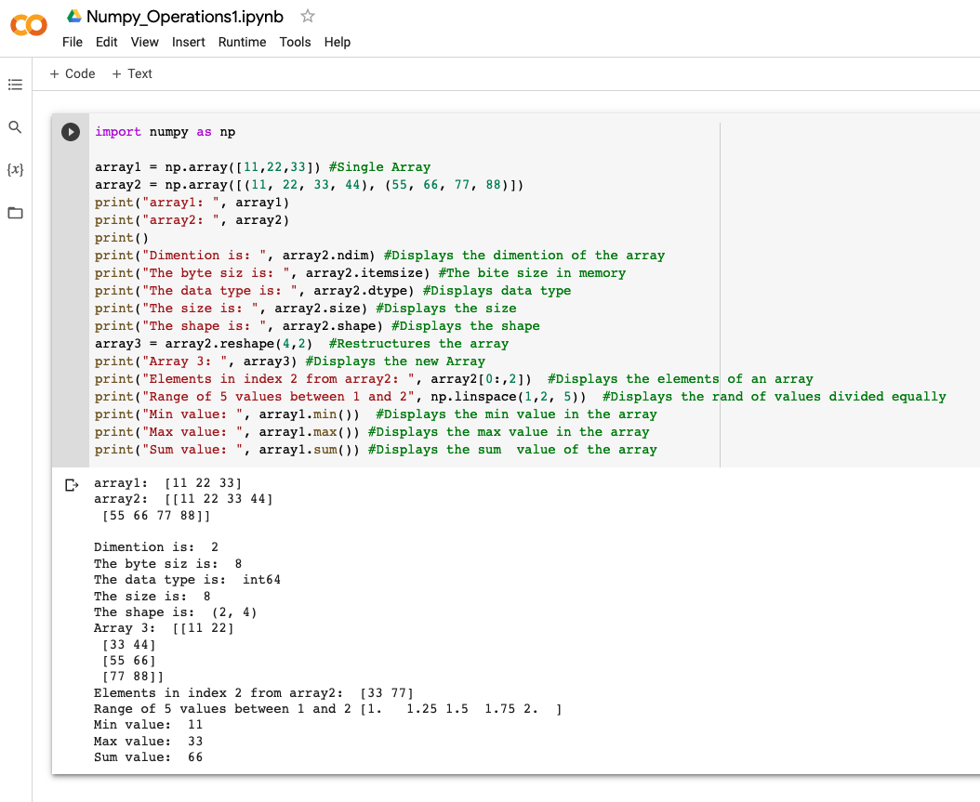
NumPy Operations
Operations
ndim
itemsize
dtype
reshape
slicing
linspace
max
min
sum
Notes:
‹#›

Slide 6
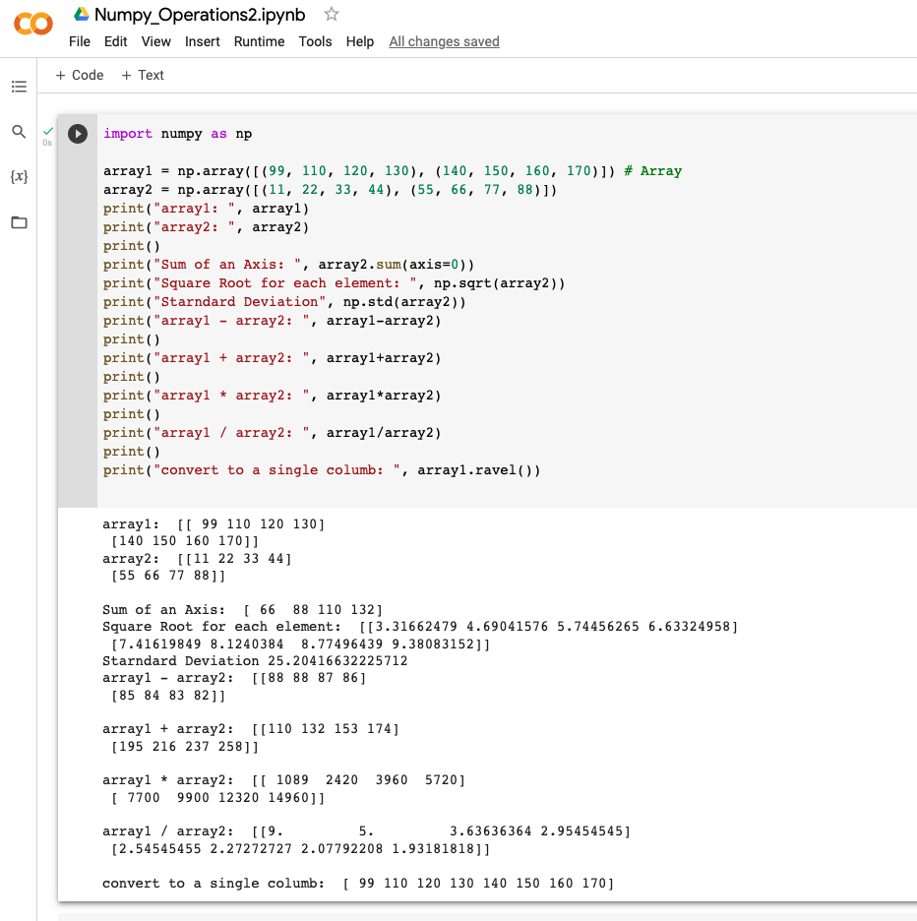
NumPy Operations (continued)
Operations
Square root.
Standard deviation.
Math operators.
Ravel.

Slide 7
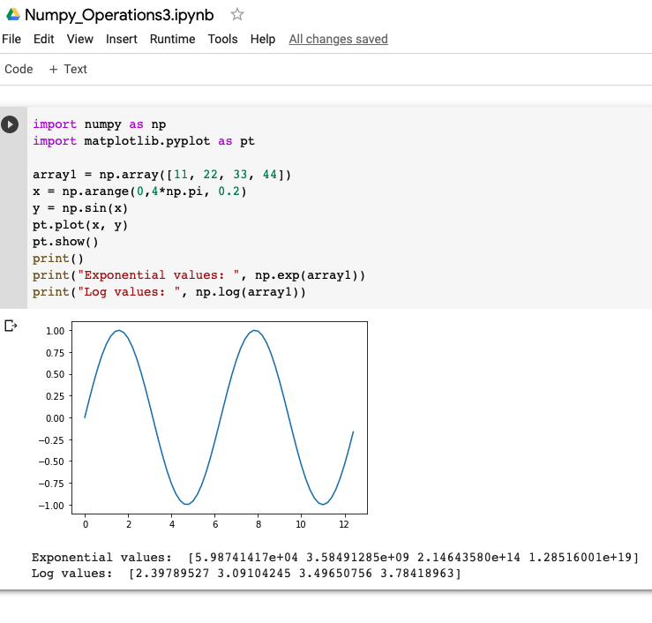
NumPy Operations (continued)
Special functions
sin(), cos(), tan()
Exponential
Log

